Slide 1









Women’s Health Agentic AI Hackathon
30
DEC
2025
Turning Clinical Challenges into Intelligent Solutions
Post- partum depression prediction system
(AI-Powered Risk Assessment & Conversational Screening)
Medical staff:
Prof. Gali Pariente
Dr. Noam Shema
Dr. Danielle Ben Ari
Technological side:
Ms. Natalia Gordon
Ms. Golda Krishtalev

Slide 2


Women’s Health Agentic AI Hackathon
30
DEC
2025
Turning Clinical Challenges into Intelligent Solutions
Introducing the problem
Postpartum depression is a common and significant medical condition.
It is under-recognized in maternity wards.
Postpartum hospitalization is a critical phase when there is an opportunity for early detection, but in practice, limited or no emotional assessment is performed.
Diagnosing postpartum depression is crucial because early detection allows timely intervention, reducing risks to both maternal mental health and infant development. Prompt treatment can improve bonding, functioning, and overall family well-being.

Slide 3


Women’s Health Agentic AI Hackathon
30
DEC
2025
Current State
Turning Clinical Challenges into Intelligent Solutions
This issue is significant due to the substantial workload on healthcare staff, limited time for comprehensive patient interactions, and the lack of integrated systems that combine medical and psychosocial data in real time. These factors collectively contribute to diminished quality of care, a negative maternal experience, and increased short- and long-term health risks.

Slide 4

Women’s Health Agentic AI Hackathon
30
DEC
2025
Main system actions
Turning Clinical Challenges into Intelligent Solutions
Not a diagnostic system, but a tool that assists in the early identification of risk, to enable timely referral and support

Slide 5

Women’s Health Agentic AI Hackathon
30
DEC
2025
Main system actions
Turning Clinical Challenges into Intelligent Solutions
In this project, we developed an AI-powered decision-support system that combines clinical and psychosocial data, explainable machine learning and conversational EPDS chatbot.
Target audience:
Medical staff in the maternity ward, the patient community gynaecologists and family doctors

Slide 6
Women’s Health Agentic AI Hackathon
30
DEC
2025
Main system actions
Turning Clinical Challenges into Intelligent Solutions
Calculating a personal risk score for postpartum depression
Adjusting questions according to risk level
Data integration with EPDS, clinical, psychosocial and emotional information
Prioritizing mothers according to risk level
Generating alerts and recommendations for the department staff
Creating an update interface for the family doctor and the gynecologist in the community after discharge for the purpose of continuity of care and follow-up (for further development)

Slide 7



Women’s Health Agentic AI Hackathon
30
DEC
2025
Turning Clinical Challenges into Intelligent Solutions
Project Overview
This project is an AI-powered Postpartum Depression (PPD) Risk Prediction System that combines:
- Machine Learning Models (XGBoost & Random Forest) for accurate risk assessment
- SHAP Explainable AI for transparent, interpretable predictions
- Algorithm questioning for medical staff (Q&A)
- EPDS Conversational Agent for natural language screening
- Interactive Gradio Interface for easy-to-use clinical assessment tools
- Domain Knowledge Integration* for medically-informed risk adjustments
The system helps healthcare professionals and researchers identify women at risk for postpartum depression by analyzing demographic, clinical, psychiatric, and psychosocial factors.

Slide 8
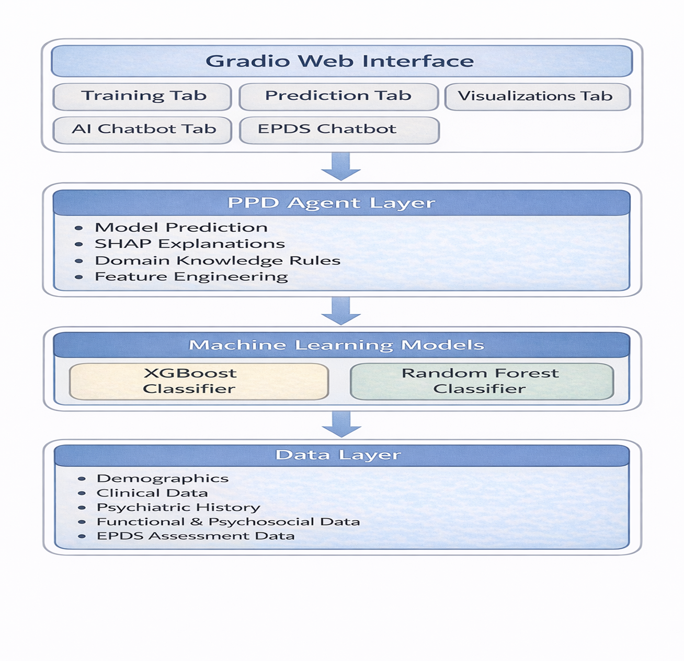
Women’s Health Agentic AI Hackathon
30
DEC
2025
Turning Clinical Challenges into Intelligent Solutions
System Architecture
This system was developed as part of PPD Prediction Prototype, focusing on:
- Machine learning model development
- Explainable AI (XAI) implementation
- Natural language processing
- Clinical decision support systems
- User interface design

Slide 9
Women’s Health Agentic AI Hackathon
30
DEC
2025
Key Features
Turning Clinical Challenges into Intelligent Solutions
1. Dual ML Algorithm Support
- XGBoost Classifier with hyperparameter optimization
- Random Forest Classifier with default parameters
- Automatic algorithm selection and comparison
- Model persistence and retraining capabilities
2. Explainable AI (XAI)
- SHAP (Shapley Additive Explanations) integration
- Feature importance visualization
- Personalized risk explanations
- Waterfall-style SHAP plots for individual predictions
3. EPDS Conversational Agent
- LangChain-powered natural language interaction
- Hebrew language support for patient conversations
- Sentiment analysis using LLM-based distress detection
- Natural language understanding for patient responses
- Automatic EPDS score calculation
4. Algorithm questioning for medical staff (Q&A)
- LangChain-powered natural language AI Chatbot
- Based on model predictions and SFAP explanations

Slide 10
Women’s Health Agentic AI Hackathon
30
DEC
2025
Key Features
Turning Clinical Challenges into Intelligent Solutions
4. Domain Knowledge Integration
- Medical rule-based adjustments
- EPDS score integration
- Risk stratification based on clinical factors
- Context-aware probability corrections
5. User-Friendly Interface
- Gradio web interface with tabbed navigation
- Real-time predictions
- Interactive visualizations
- Model training controls
- Agent chat interfaces (General AI & EPDS)
6. Comprehensive Visualizations
- Target distribution plot
- Feature distributions by target class
- Confusion matrix
- ROC curve with AUC score
- Prediction probability distributions
- Correlation heatmaps
- SHAP summary plots​

Slide 11
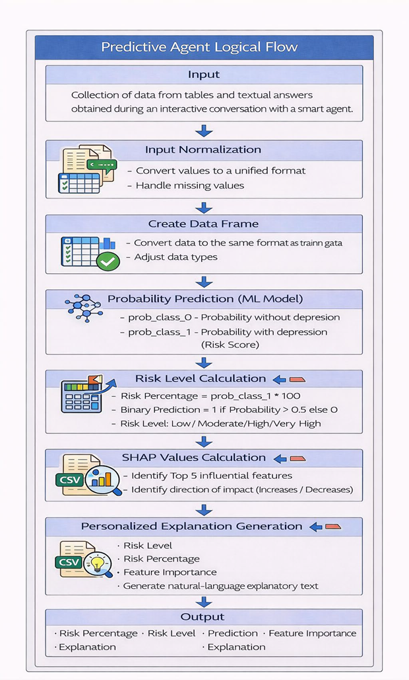

Women’s Health Agentic AI Hackathon
30
DEC
2025
Turning Clinical Challenges into Intelligent Solutions
ML Models & AI Agents
Model Options
1. XGBoost/Random Forest Classifiers
- Hyperparameter optimization
- Evaluation metric: ROC AUC score
2. Model Performance
- Models are evaluated using:
- ROC AUC Score
- Confusion Matrix
- Classification Report
- Performance metrics are displayed in the interface

Slide 12
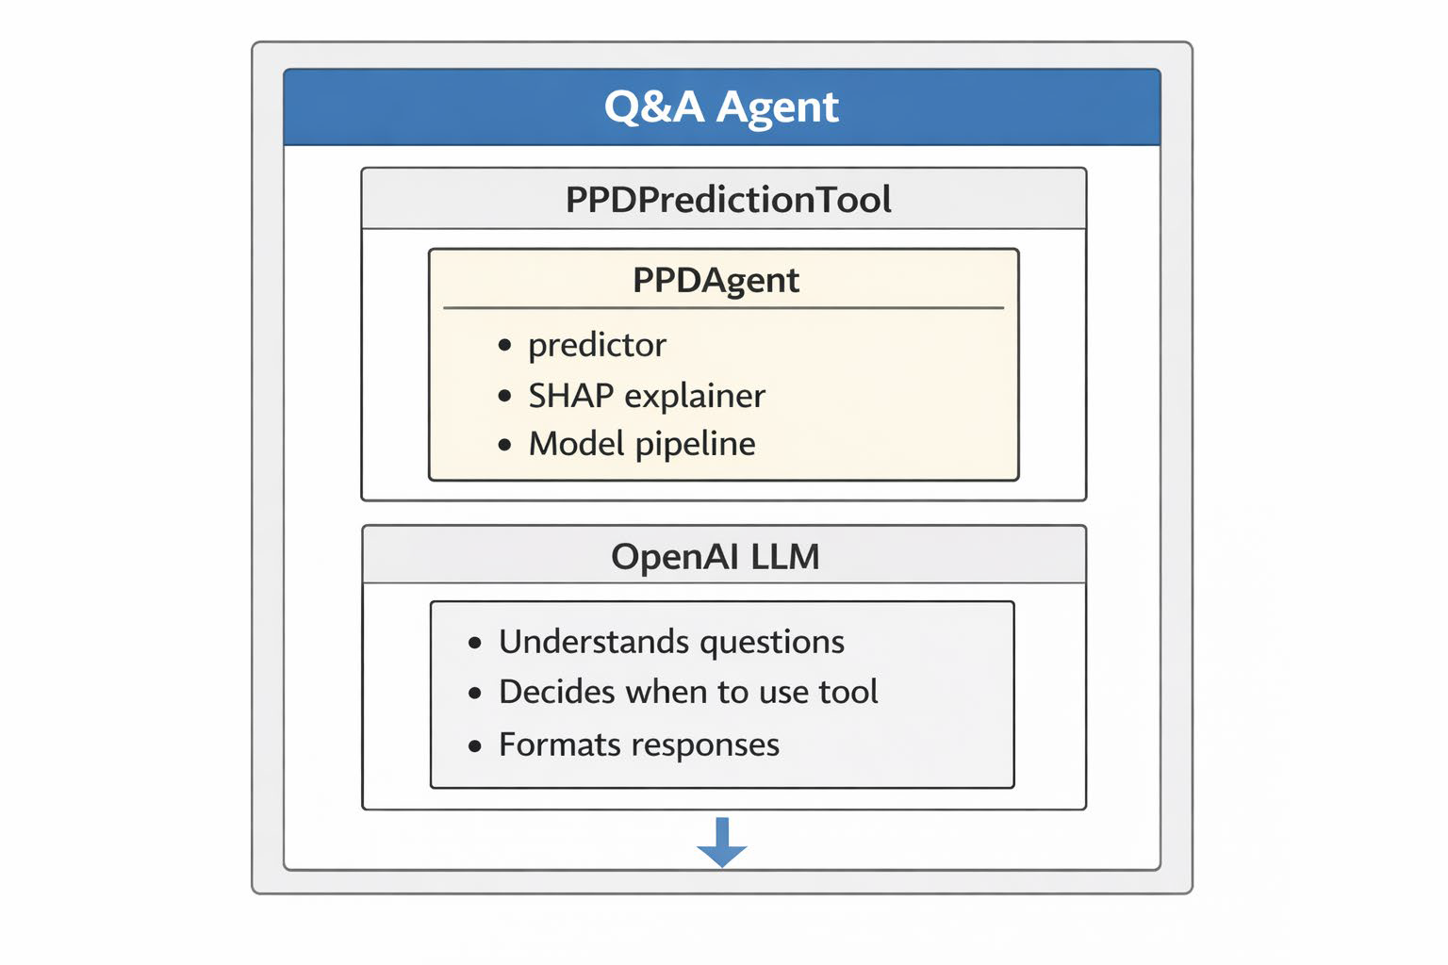
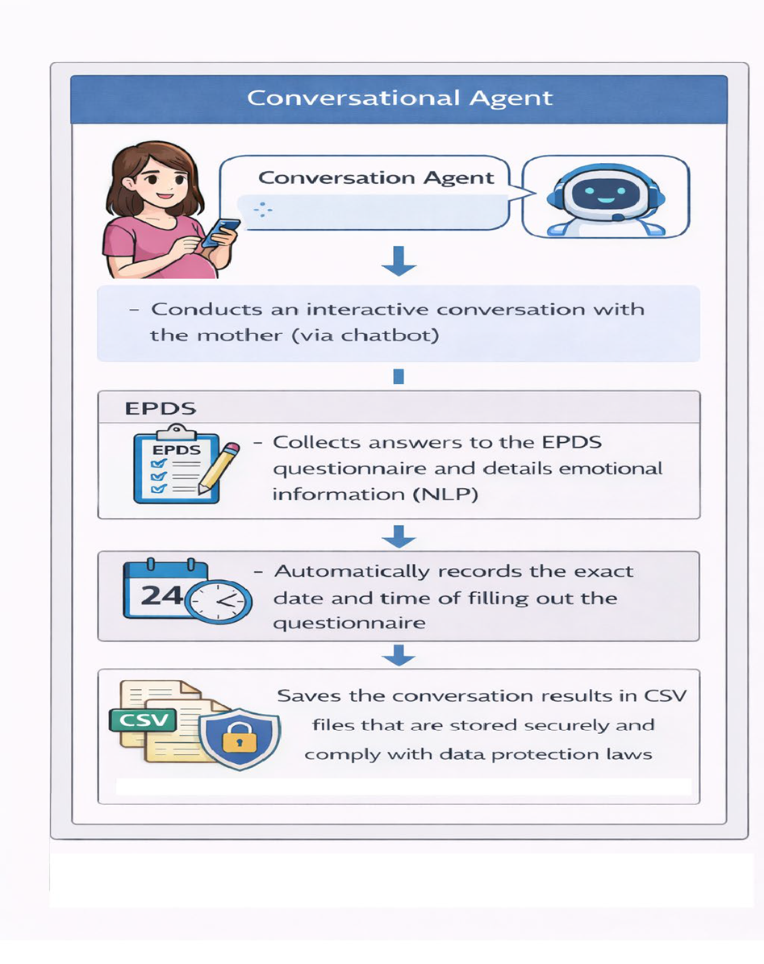
Women’s Health Agentic AI Hackathon
30
DEC
2025
Turning Clinical Challenges into Intelligent Solutions

Slide 13
Women’s Health Agentic AI Hackathon
30
DEC
2025
Demo & UI
Turning Clinical Challenges into Intelligent Solutions
1. Training Tab
- Algorithm selection (XGBoost/RF)
- Hyperparameter optimization toggle
- Training status and performance metrics
- Model save/load functionality
2. Prediction Tab
- Patient data input form
- Real-time risk prediction
- Risk percentage and level
- Top 5 feature importance
- Personalized explanation - SHAP visualization
3. Visualizations Tab​
- Target distribution​
- Feature distributions​
- Confusion matrix​
- ROC curve​
- Prediction distribution​
- Correlation heatmap​
- SHAP summary plots​
4. AI Chatbot Tab
- LangChain-powered conversational agent
- Natural language queries about PPD risk
- Example questions provided
- Integration with PPD prediction mode
5. EPDS Chatbot Tab
- EPDS conversational assessment
- Natural language patient interaction
- Sentiment analysis and distress detection
- Automatic scoring and risk assessment
- Crisis resource provision

Slide 14

Women’s Health Agentic AI Hackathon
30
DEC
2025
Turning Clinical Challenges into Intelligent Solutions
Feasibility & Implementation
Planned actions for further implementation:
Adjusting questions according to risk level
Prioritizing mothers according to risk level
Creating an update interface for the family doctor and the gynecologist in the community after discharge for the purpose of continuity of care and follow-up
Planned Improvements:
- Additional ML algorithms (SVM, Neural Networks)
- Real-time data streaming integration
- Multi-language support expansion
- Mobile app interface
- Electronic Health Record (EHR) integration
- Longitudinal risk tracking -
Clinician dashboard
- Patient portal
- Automated report generation
- API deployment

Slide 15
Women’s Health Agentic AI Hackathon
30
DEC
2025
Turning Clinical Challenges into Intelligent Solutions
Value & Influence
Identification during a critical early postpartum window
Immediate access to in-hospital psychiatric consultation and treatment
Early intervention before symptom escalation
Structured discharge planning with mental health follow-up
Improved continuity of care between hospital and community

Slide 16

Women’s Health Agentic AI Hackathon
30
DEC
2025
Turning Clinical Challenges into Intelligent Solutions
KPI’s – Key Performance Indicators
Early Intervention Lead Time- Generate automated risk alerts within an average of 24 hours from patient admission to enable pre-discharge support.
Alert Precision- Maintain a 75% Positive Predictive Value (PPV) to ensure clinical relevance and minimize alert fatigue for medical staff.
Universal Screening Coverage- Ensure autonomous AI-driven screening and analysis for 85% of all new maternity ward admissions.
Clinical Impact Ensure 90% of AI-flagged high-risk patients receive a documented consultation with a mental health professional before discharge.

Slide 17
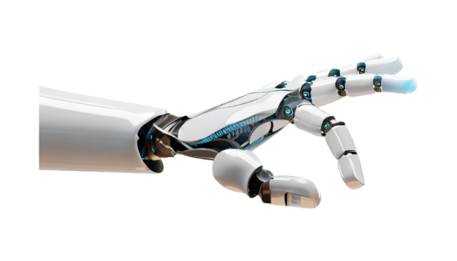
Women’s Health Agentic AI Hackathon
30
DEC
2025
Turning Clinical Challenges into Intelligent Solutions
Thank You!

